Slide 1



Slide 2
About today…
React Hooks
contextAPI

Slide 4

What is Context API
Definition
A mechanism to manage and share state globally in a React application
Core components
Context, Provider, and Consumer
Use cases
Avoiding prop drilling, managing global state, theme toggling

Slide 5
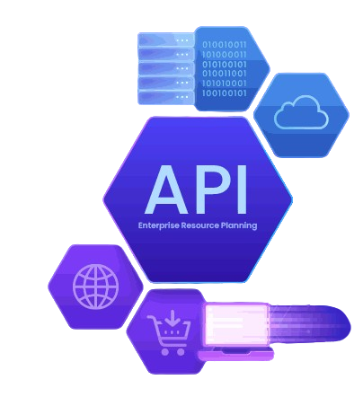
Core Concepts
Context
Holds the state and provides it to child components
Provider
Component that wraps parts of the app where the context should be available
Consumer
Component that subscribes to the context to access the state

Slide 6

Creating a Context
Explanation
Import createContext
Creating a context instance: const MyContext = createContext();

Slide 7

Using Provider
Explanation
Wrapping components with ‘Provider’
Passing value to ‘Provider’

Slide 8
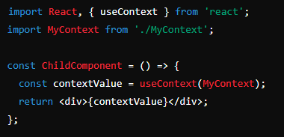
Consuming Context
Explanation
Using useContext Hook (for functional components)
Accessing context value

Slide 9

What does the createContext function return?
It returns a Context object with two properties: Provider and Consumer (or a useContext hook in function components)
What is the purpose of the Provider component in the Context API?
The Provider component is used to supply the context value to its descendant components
How do you access context values inside a functional component?
Use the useContext hook, passing the context object as an argument
How can you update the context value from a child component?
By passing functions to update the state (such as increment or decrement) through the context value and calling these functions in the child component using useContext

Slide 10


Slide 11

Task
Use Context API to manage and display a greeting message

